Slide 1


Youth Unemployment in the IT Sector
Work: Research Scholar @ilabAfrica
Aspirations: Leverage data science to uncover insights
Passion for Data Science: Believe in its power to drive positive change through applying data-driven approaches
Research Scholar - Lindah Kelida
25 August 2023

Slide 2
Table of Content
01
04
Introduction
Results
Problem statement
Data Visualizations
Exploratory Data Analysis
05
02
Streamlit
Methodologies Used
User Friendly App
03
06
Data Preprocessing
Conclusión
Variables, Cleaning, Transformation
Recommendations, Impact, and Contributions

Slide 3

Problem Statement
A hackathon to address the pressing issue of youth unemployment in the IT sector.
Using data science techniques to uncover insights related to youth employment in Kenya's IT sector.

Slide 4


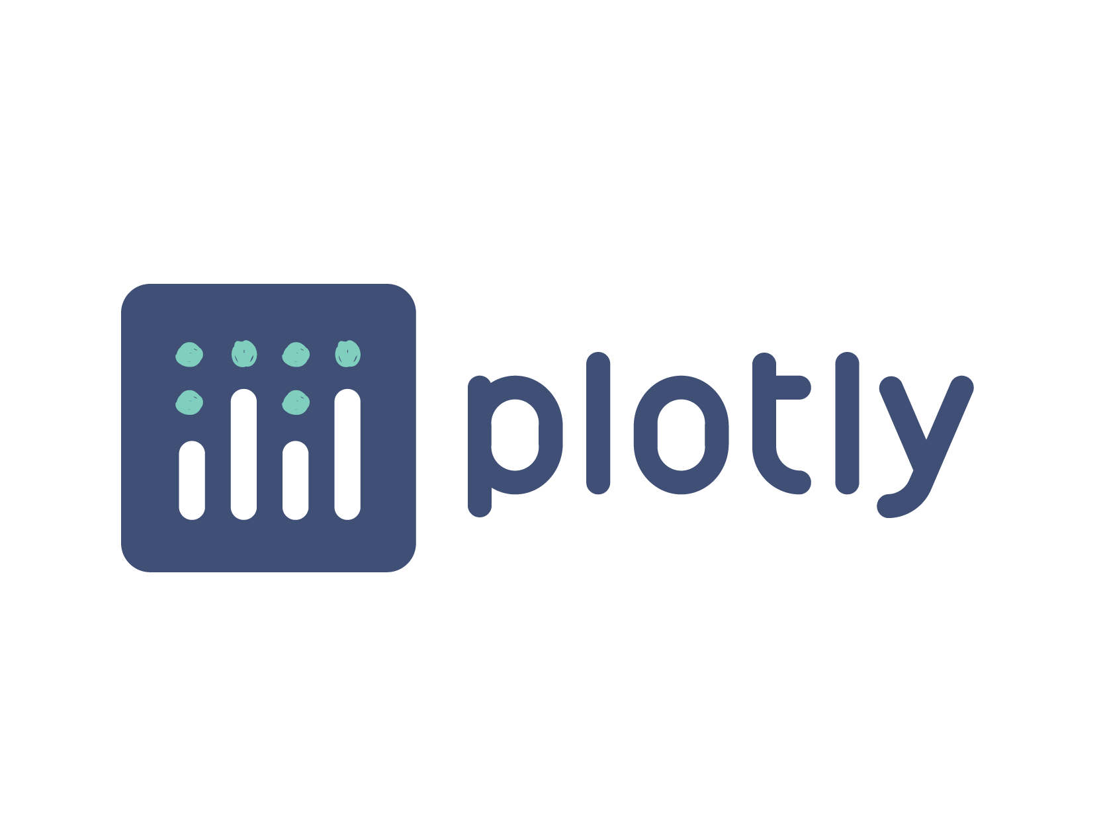

Methodolgy
Structured Approach:
Data Collection, Preprocessing,
EDA, Visualization
Tools and Techniques:
Python, Plotly, Streamlit
Dashboard Deployment:
Interactive Visualization

Slide 5




Data Selection & Preprocessing
Variable Selection
Country, age group, sex, year, population, employment categories, and education levels for analysis
Data Cleaning and Merging
Derived metrics, like unemployment rates and shares, were calculated to provide additional context for the analysis
Data Transformation
Derived metrics, like unemployment rates and shares, were calculated to provide additional context for the analysis
Feature Engineering
Creating new variables from the abs_value column

Slide 6
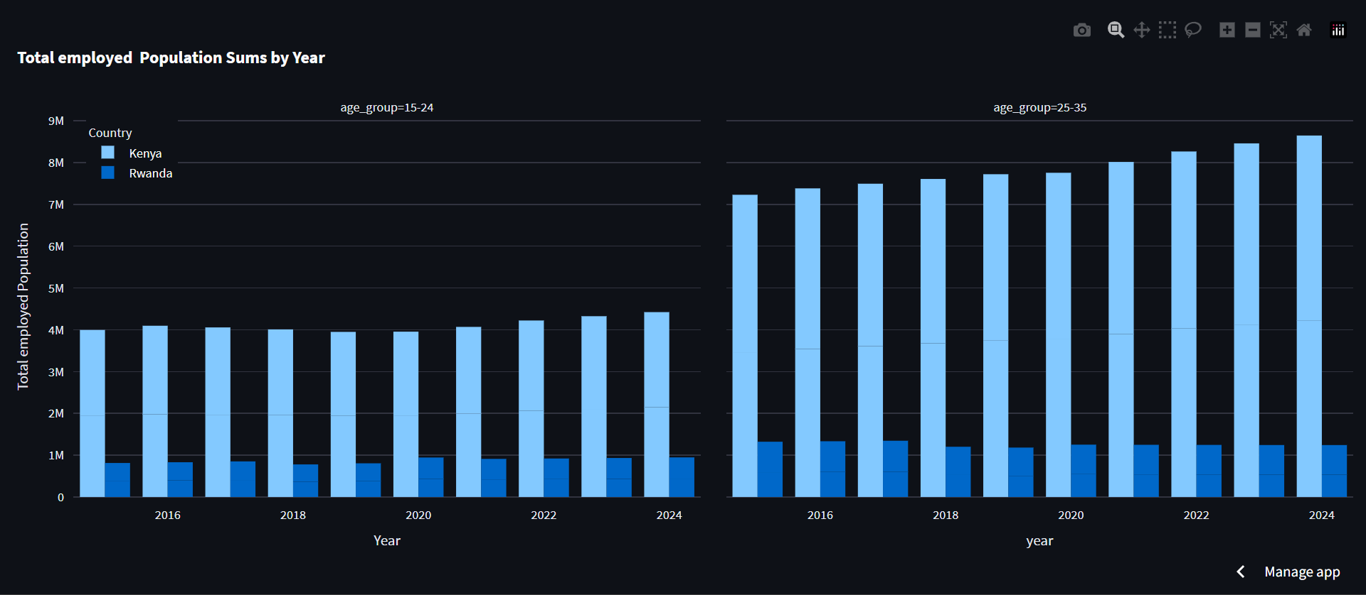
Results
Interactive Dashboard: Showcases employment, education, and demographic trends. Link: Youth Unemployment Dashboard
Unemployment Insights: Unemployment rates among youth across different demographics and time periods.
Education Impact:
the impact of education levels on employment outcomes within the IT sector.

Slide 7
Findings and Insights
Employment Trends: The analysis reveals a consistent increase in youth employment rates within the IT sector over the years.
Gender Disparities: Findings indicate significant gender disparities, with males being more represented in the workforce than females.
Comparative Analysis: Comparing Kenya and Rwanda's employment trends uncovers shared regional patterns and slight differences in unemployment rates and education distributions.

Slide 8
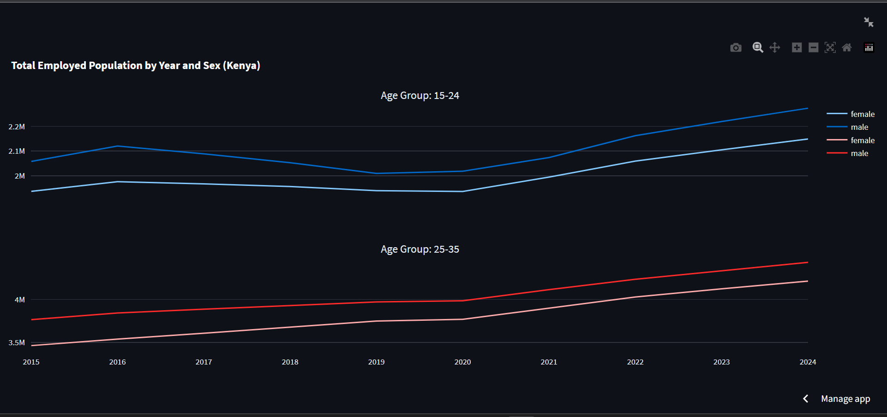
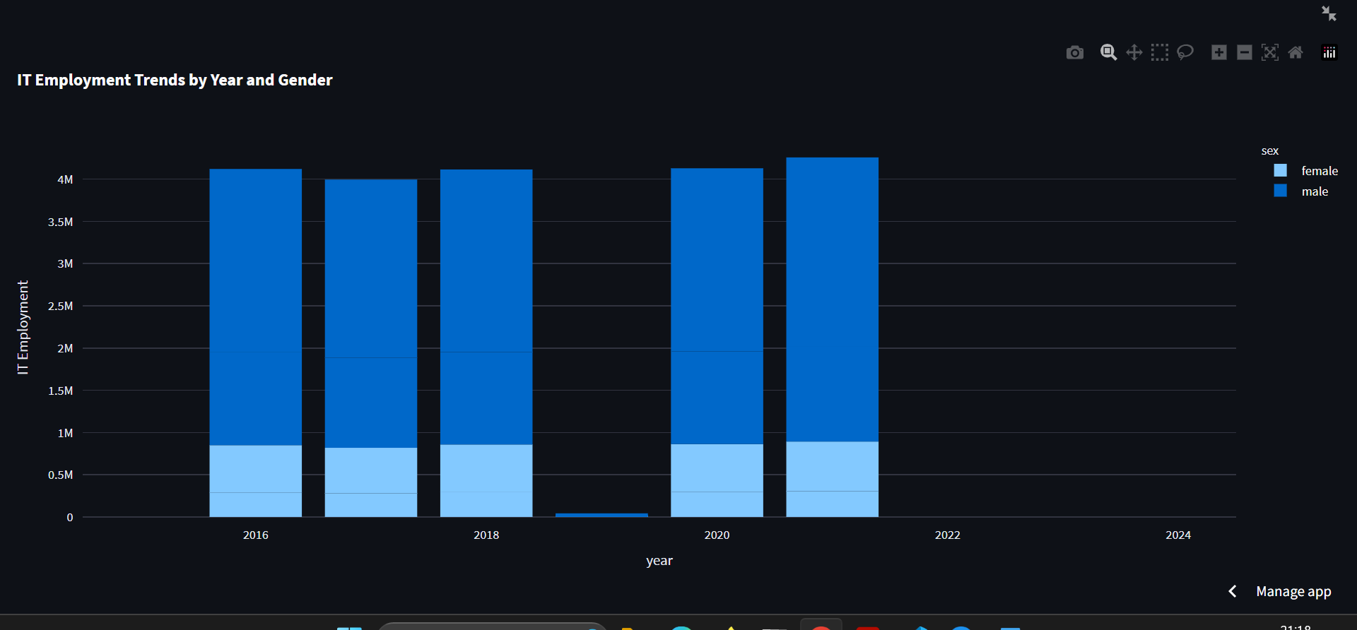

Slide 9
Recommendations, Impact, & Contributions
Stakeholder Recommendations: Recommendations include promoting STEM education, aligning curriculum with industry demands, and implementing diversity initiatives.
Potential Impact: Implementing these recommendations can lead to enhanced youth employability, gender equality, and a more skilled IT workforce.
Project Contributions: The project's contributions encompass comprehensive analysis, an interactive dashboard, actionable recommendations, and data-driven decision-making.

Slide 10
Thank You!
Any questions?

